Slide 1
Counting the Chickens While They Hatch and the Double Edged Sword of Tracking Project Claims and Delays
Plenary Session 4
ABA Forum on the Construction Industry
April 10-12, 2014
2014 Annual Meeting
Allen Estes - Gordon & Rees, LLP
John Livengood – Navigant
Andrew Rhodes - The Rhodes Group

Slide 2
INTRODUCTION
Owners and Contractors should focus on the importance of having project procedures/mechanisms in place to monitor and document the costs of change orders or claims to maximize the potential for appropriate recovery or defense against unjustified claims.

Slide 3
$
$
Planned Project
Completion
Time
Time

Slide 4
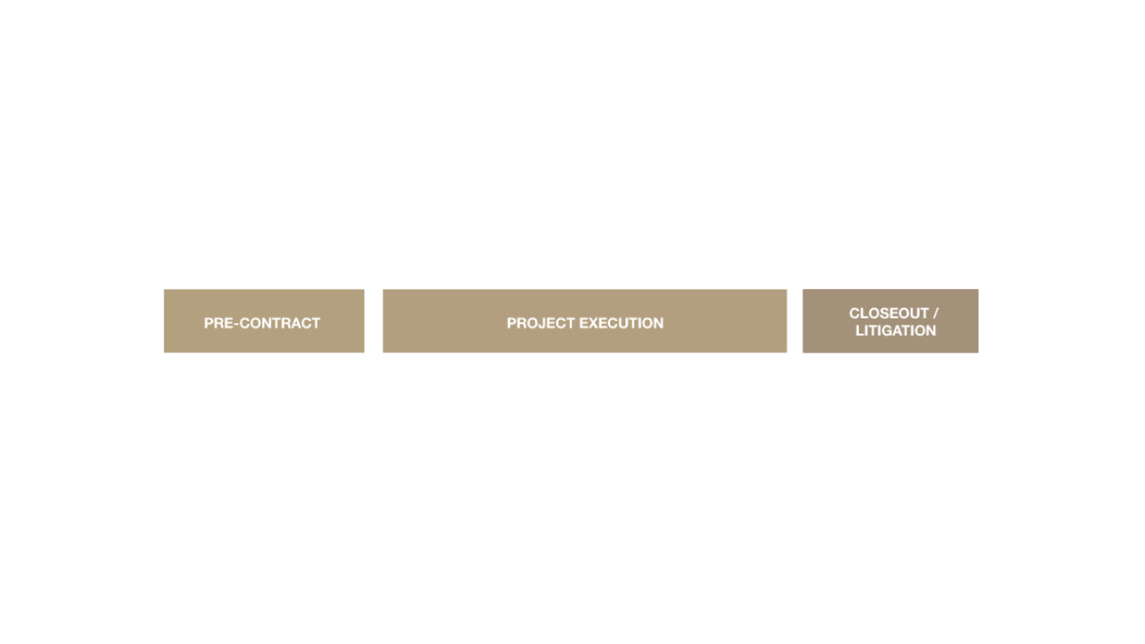
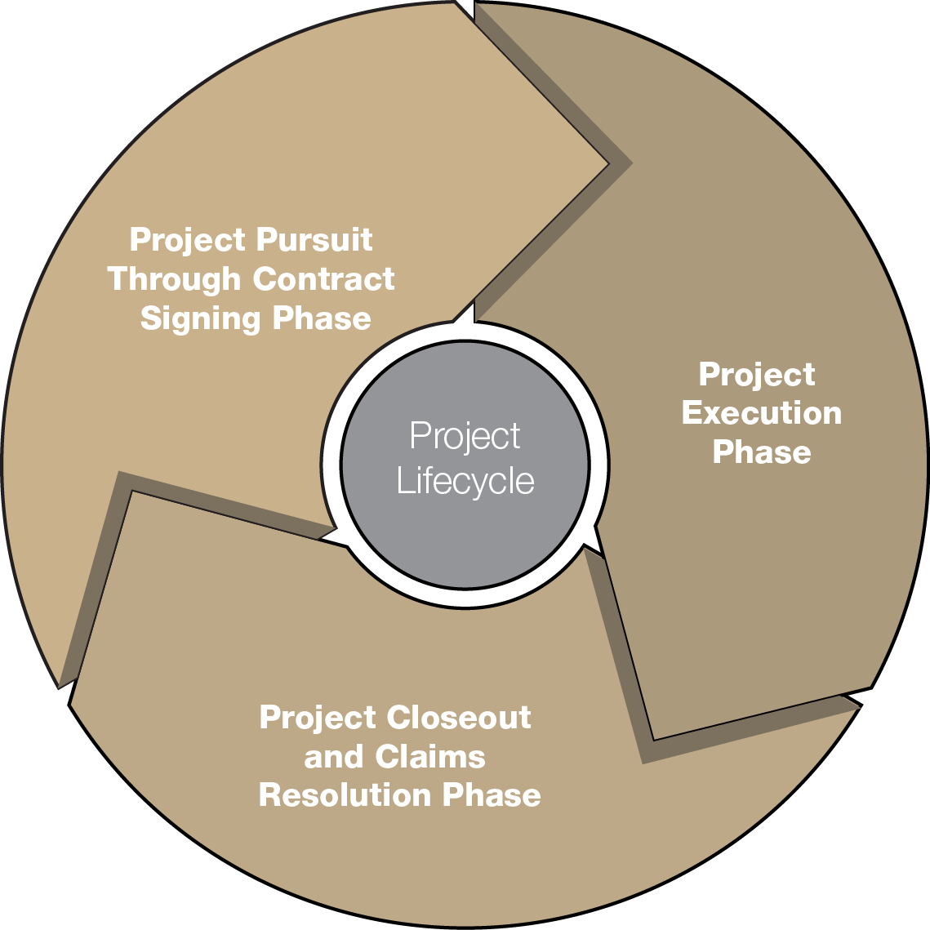
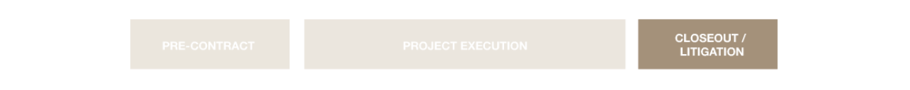
Why do We Run into the Same Issues?

Slide 5
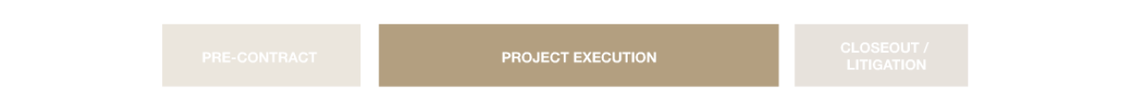
Why do We Run into the Same Issues?
Building
Strategizing
Planning
Disputing
Tracking
Substantiating

Slide 6

Why do We Run into the Same Issues?
VS
Institutional Knowledge
Personal Knowledge

Slide 7
Why do We Run into the Same Issues?
Relationships
Optimism Bias
Did not Read the Contract
Cost-Reimbursable Mindset
Up-Stream/Down-Stream Coordination
Lack of Resources (too busy)
Lack of Expertise

Slide 8
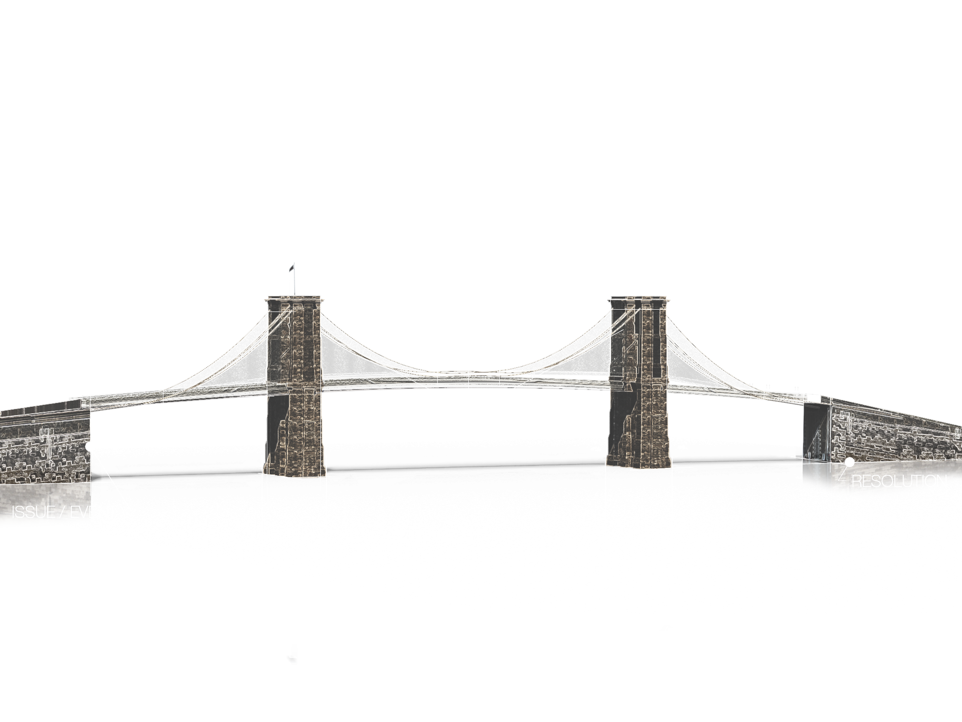
Why do We Run into the Same Issues?

Slide 9
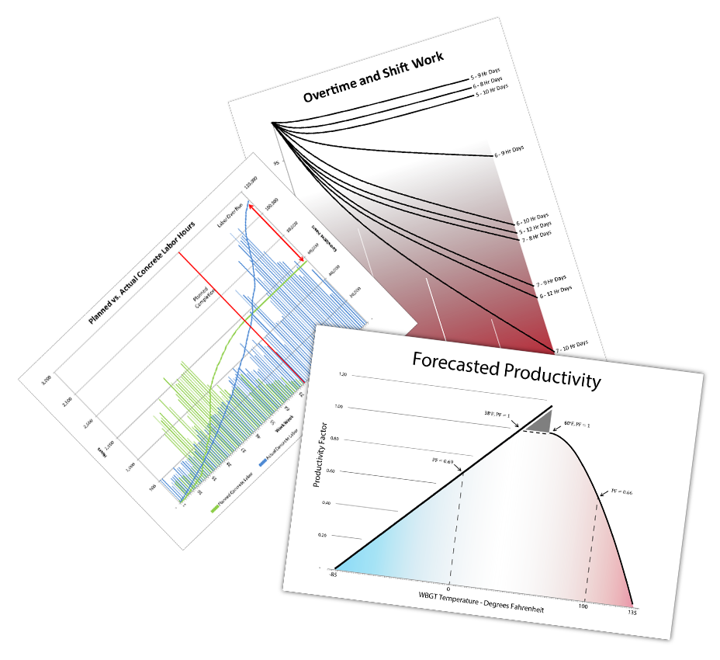
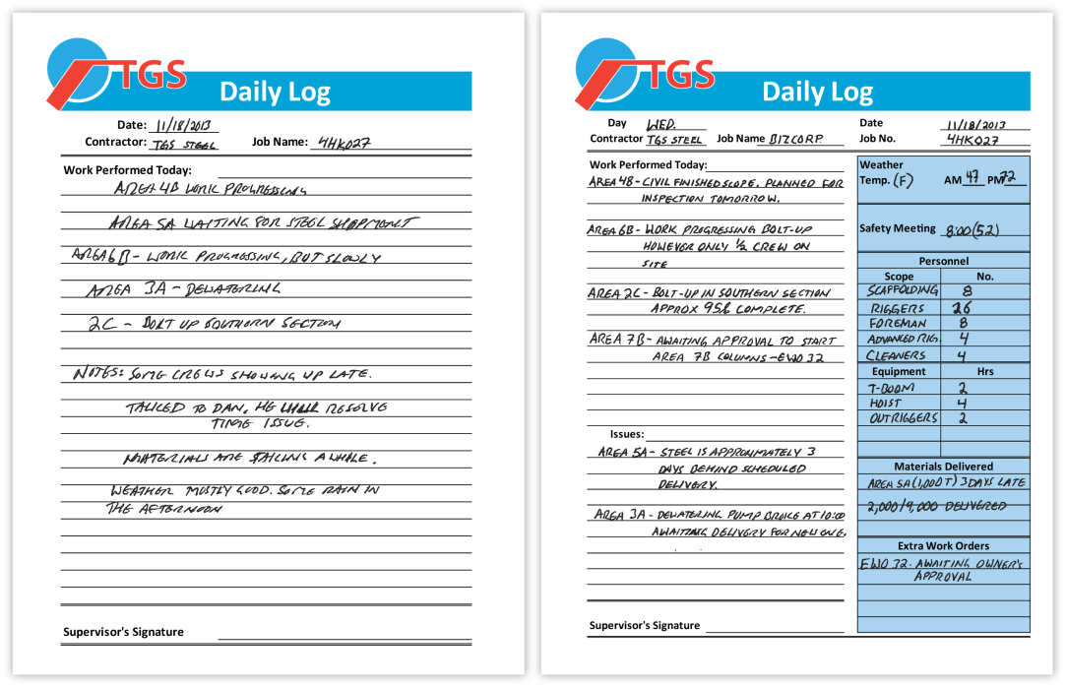
Project Records

Slide 10
AGENDA
Introduction
Establishing legal entitlement
Establishing technical entitlement
Example 1: Differing Site Condition
Example 2: Schedule Delay
Wrap-up and Q&A

Slide 11
LEGAL ENTITLEMENT
Define Legal Entitlement
  Basis in law for the claim
Based on contract requirements
  Each contract is different
Substantiated by documents that adhere to contract requirements
  Track events giving rise to claims
  Ensure timely notice
  Other required support

Slide 12
TECHNICAL ENTITLEMENT
Define Technical Entitlement
  Based on Analysis completed either as outlined by the contract or utilizing industry accepted methodologies
Scope of Work Change Technical Entitlement
    Photos
    Technical drawings and submissions
    Soil Reports
    Equipment cuts
    Detailed Cost estimates

Slide 13
TECHNICAL ENTITLEMENT
Schedule Technical Entitlement
  Based on Analysis
  Method Identified in Contract or utilizing industry accepted methodologies
    Schedule Delay and Extension
    Schedule Acceleration
    Impacted Productivity
Dependent upon completeness and accuracy of available records

Slide 14
LEGAL ENTITLEMENT
Example 1
Example: Foundation subcontractor responsible for CIDH pile needed to support the foundation of a building.
  Ideal Situation
  Reality

Slide 15
LEGAL ENTITLEMENT
EXAMPLE 1
Contracts typically identify specific process
Common Pitfalls –
  Failure to follow Notice requirements
  Stopping work
  Reasonable investigation & either stop-work or notice to proceed
  Substantiation
  Evaluation of claim
  Accord or dispute (DRB, litigation)

Slide 16
EXAMPLE 1
IDEAL:
Performs Site Investigation
Waits for NTP
Maintains detailed DRs
Stops Work
Promptly Provides Written Notice
REALITY:
Relies on soil reports in Docs
Starts before NTP
Maintains Diary
Continues Working
Provides Oral Notice
Written Notice Late

Slide 17
EXAMPLE 1
IDEAL:
Contractor Segregates Costs
Contractor Develops TIA
Owner and Contractor Meet
Equitable Adjustment is negotiated
Contractor and Owner move on to other aspects of the Work
REALITY:
Contractor Mixes costs
Contractor submits Total Time claim
Contractor and Owner cannot agree.
Contractor proceeds to DRB or other dispute process
DRB issues opinion and One side is disappointed.
Project does not continue smoothly

Slide 18
WHY DID IT GO WRONG?
EXAMPLE 1
Contractor failed to perform a sufficient investigation of the soil reports included in the documents.
Contractor failed to sufficiently inform project personnel of the terms of the contract
Contractor insisted on proceeding too quickly.

Slide 19
WHY DID IT GO WRONG?
EXAMPLE 1
Contractor, tried to keep good relations by giving a “friendly” notice of DSC
Contractor tried to save money on documenting extra costs
Contractor had no capability to do a proper delay analysis.

Slide 20
LESSONS LEARNED
EXAMPLE 1
Project Staff must know the contract and what it means.
Contractor and Owner are neither friends nor enemies – they are working together on a project – there is no place for friendship in lieu of contract requirements
Contractor needs to plan better so it can spend money in compliance with the contract requirements, and not try to save it by providing less management.

Slide 21
EXAMPLE 2
Schedule Delay

Slide 22
TECHNICAL ENTITLEMENT
Example 2
During the course of the project, there were significant weather delays, owner changes, productivity problems and the requirement to maintain the original completion date.

Slide 23
TECHNICAL ENTITLEMENT
Example 2
As a result, the contractor prepared TIAs contemporaneously with some of the delays, and yet submitted an “wrap-up” delay claim that incorporated granted time extensions, weather delays, owner delays and alleged productivity impacts resulting from the many separate changes issued by the owner and the necessary acceleration

Slide 24
TECHNICAL ENTITLEMENT
Schedule Delay
The ability to apply a methodology is contingent upon available source material
Defining the Delay:
  Excusable
  Inexcusable
  Compensable
  Concurrent
  Apportioned

Slide 25
TECHNICAL ENTITLEMENT
Schedule Delay
Types of Acceleration
  Voluntary
  Directed
  Constructive
  Acceleration to Recover from Concurrency
Proving acceleration and the related records

Slide 26
EXAMPLE 2
IDEAL:
Contractor submitted a reasonable cost-loaded baseline schedule at the outset of the project: approved by the owner
The contractor maintained a vigorous program for monthly update: submitted timely and approved.
The contractor prepared TIAs contemporaneously for all changes identified on the project and negotiated them, predicated on the detailed schedule collection that was available
REALITY:
Contractor eventually delivered a baseline schedule that was rejected.
The Contractor periodically submitted update schedule: always depicted owner delays – they were rejected
The Contractor submitted some impacted as-planned submissions (masquerading as TIAs) after the work was completed: asserted all delay to be the responsibility of the Owner.

Slide 27
EXAMPLE 2
IDEAL:
At the end of the project there were some unresolved schedule delays that were prepared using an agreed upon methodology that showed some delays were the responsibility of the owner, some the Contractor, and some were concurrent.
The parties settled their disputes amicable, with the Fairy Godmother acting as mediator.
REALITY:
At the end of the project, almost all delays issues remained unresolved, even for those that direct costs had been agreed to.
The parties attempted mediation and then entered into a protracted trial where the schedule delay experts duked it out. The judge could not understand either delay expert and essentially tossed a coin.

Slide 28
WHY DID IT GO WRONG?
EXAMPLE 2
Contractor failed to timely follow the contract requirements for submission of PROSPECTIVE costs and time
Contractor was “too busy” doing the work to forward-price the owner’s changes
The Contractor relied on the friendly relations between Owner and Contractor
Contractor failed to recognize all potential changes
Contractor was “too busy” doing the work to monitor and record activities

Slide 29
LESSONS LEARNED
EXAMPLE 2
The additional cost of documenting labor and costs is worth it
Jeopardizing contractual obligations due to maintaining client relationships
Forecast work to be performed at the most realistic durations, not optimistic

Slide 30
CONCLUSION
Establishing legal and technical entitlement are integral to substantiating any claim
Creation and maintenance of project documentation with a consciousness toward claims can greatly affect how useful they are in this capacity

